Slide 1
Sparsity Techniques

Slide 3
3 Studies in Power System Analysis
Load Flow is a Static Study (Static Study means not change at each and every instant, it is constant)
Stability Study is a Dynamic Study, because any state our power may be unstable.
Load Flow Study
Stability Study
Fault Study

Slide 5
Load Flow Study Is a Static or Dynamic Study
Load Flow is a Static Study (Static Study means not at each and every instant, it is constant)
Stability Study is a Dynamic Study, because any state our power be a unstable.

Slide 7
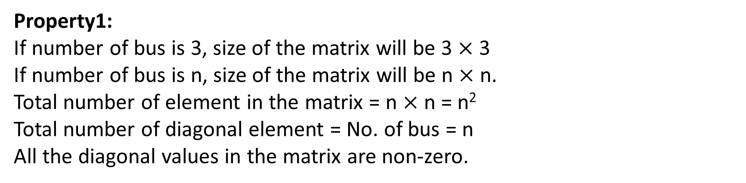
Sparsity of Y-Bus Matrix
Sparsity of the Y_{bus} matrix is defined as the ratio of total number of zero element to the total number of element in the Y_{bus} matrix.
$$Sparsity of Y_{bus} in \%=\frac{Total number of Zero element}{Total element in Y_{bus}} ×100$$
Calculation of Sparsity of Y-Bus
Property1:
If number of bus is 3, size of the matrix will be 3 $×$ 3
If number of bus is n, size of the matrix will be n $×$ n.
Total number of element in the matrix = n $×$ n = n²
Total number of diagonal element = No. of bus = n
All the diagonal values in the matrix are non-zero.

Slide 9
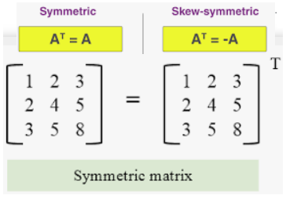
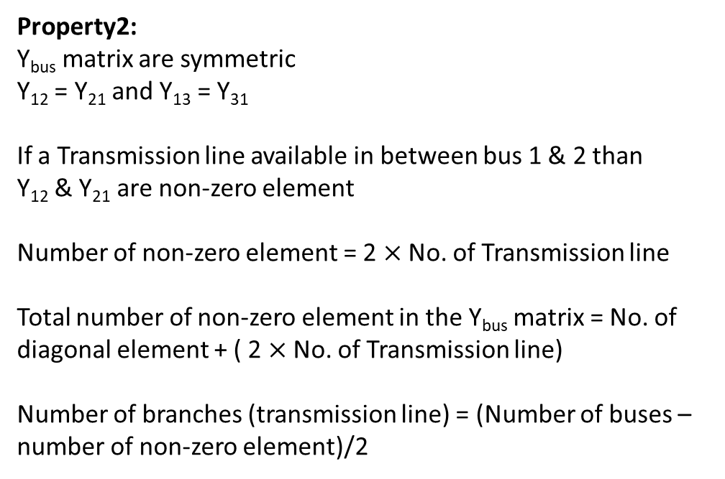
Calculation of Sparsity of Y-Bus
Property2:
Y_{bus} matrix are symmetric
Y₁₂ = Y₂₁ and Y₁₃ = Y₃₁
If a Transmission line available in between bus 1 & 2 than
Y₁₂ & Y₂₁ are non-zero element
Number of non-zero element = 2 $×$ No. of Transmission line
Total number of non-zero element in the Y_{bus} matrix = No. of diagonal element + ( 2 $×$ No. of Transmission line)
Number of branches (transmission line) = (Number of buses – number of non-zero element)/2

Slide 11
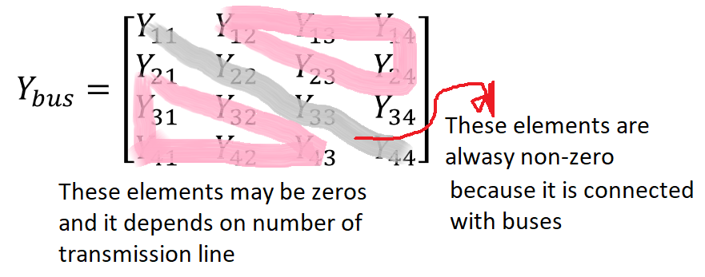
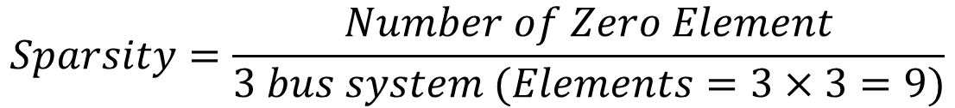
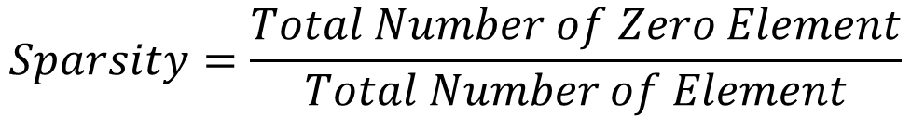
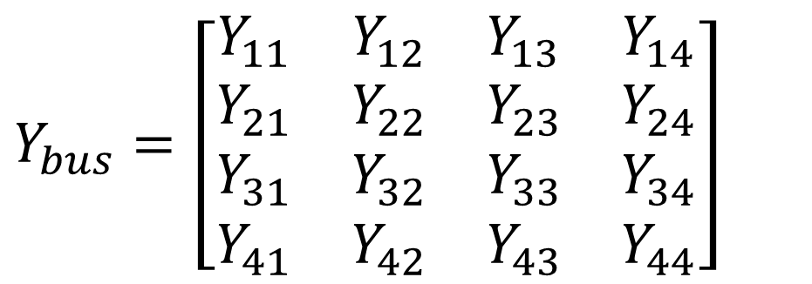
Sparse (Zero Values) Matrix In Power System
$$Sparsity=\frac{Total Number of Zero Element}{Total Number of Element}$$
$$Sparsity=\frac{Number of Zero Element}{3 bus system (Elements=3×3=9)}$$
$Y_{bus}=\left[\begin{matrix}Y_{11} & Y_{12} & Y_{13} & Y_{14} \\ Y_{21} & Y_{22} & Y_{23} & Y_{24} \\ Y_{31} & Y_{32} & Y_{33} & Y_{34} \\ Y_{41} & Y_{42} & Y_{43} & Y_{44}\end{matrix}\right]$

Slide 13
QUIZ: Suppose we used 3-admittance buses and than how many transmission lines.
Ans: Transmission Lines are also 3.
QUIZ: If we reduce the number of Transmission line from 3 to 2 than which elements are possible to be zero?
Ans: Any two elements should be zero but both elements are same such as (Y12 and Y21 or Y13 and Y31 than remaining non-zero is)

Slide 15

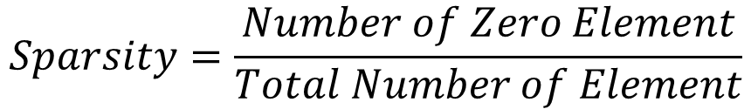
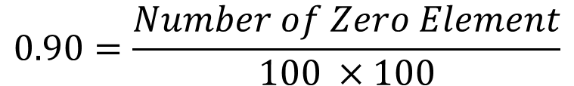

Q: The Y bus matrix of a 100 bus interconnected system is 90% sparse. Then find the number of non zero in the Y bus matrix?
SOLUTION
$$100 Bus=matrix value is 100 × 100 like 3−Bus System matirx is 3 × 3$$
$$Sparsity=90\%=0.90$$
$$Sparsity=\frac{Number of Zero Element}{Total Number of Element}$$
$$0.90=\frac{Number of Zero Element}{100 ×100}$$
$$0.90×100 ×100=Number of Zero Element$$
$$9000=Number of Zero Element$$
$$Number of Non−Zero Element=Total Number of Element −Number of Zero Element$$
$$Number of Non−Zero Element=100×100−9000=1000$$

Slide 17
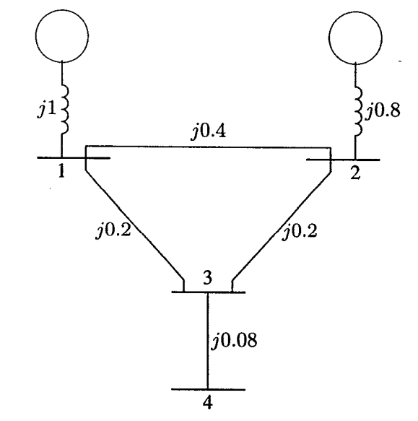
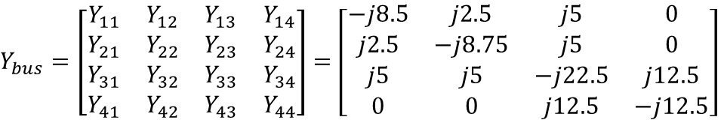



Q: Check Sparsity with Previous Solved Example of Bus Admittance Matrix
$Y_{bus}=\left[\begin{matrix}Y_{11} & Y_{12} & Y_{13} & Y_{14} \\ Y_{21} & Y_{22} & Y_{23} & Y_{24} \\ Y_{31} & Y_{32} & Y_{33} & Y_{34} \\ Y_{41} & Y_{42} & Y_{43} & Y_{44}\end{matrix}\right]$ $=\left[\begin{matrix}−j8.5 & j2.5 & j5 & 0 \\ j2.5 & −j8.75 & j5 & 0 \\ j5 & j5 & −j22.5 & j12.5 \\ 0 & 0 & j12.5 & −j12.5\end{matrix}\right]$
FIGURE 1: The impedance diagram of a simple system
$$4 Bus=matrix value is 4 ×4$$
$$Number of Zero Element=4$$
$$Total Number of Element=16$$
$$Sparsity=\frac{Number of Zero Element}{Total Number of Element}=\frac{4}{16}=0.25=25\%$$

Slide 19
Q: a 1000 x 1000 bus admittance matrix for an Electric Power System has 8000 non-zero elements. The minimum number of branches (transmission & transformer) in this system are
SOLUTION
Number of branches (transmission line) = (Number of buses – number of non-zero element)/2
Number of branches (transmission line) = (1000 – 8000)/2 = 3500 --- Answer

